Slide 1
Grading Options Using Established Benchmarks
Notes:
Please see explanation on each slide.
(Please know that there is animation in this deck = easy to lead in PPT.)
In this session we will explore grading options that you may wish to consider. It is very important that you have already established usage expectations.
Once benchmarks have been set, we can compare what we expect learners to have completed with where they actually are in their Rosetta Stone Course. We recommend that this comparison be performed on a weekly basis so that goal reminders and recognition are communicated often. This will encourage learner engagement and commitment.

Slide 2
The Formula
Notes:
In this next section, we will discuss how to easily get your grades for all your learners within a matter of minutes. Once again, it is important that you have first established your benchmarks and second, chosen how you would like to grade your learners from one on the scenarios we just reviewed.
In the following example, we will be using scenario #2, exporting all the learners’ actual Overall Progress and dividing it by the expected Progress in the established benchmark.

Slide 3
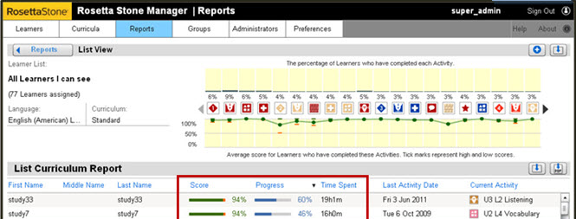
Exporting the List Curriculum Report to Excel
Notes:
From the List Curriculum Report, we will click on the green XLS button, found here on the right side of the report.

Slide 4
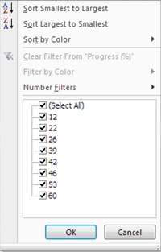
Filtering Your List Curriculum Report in Excel
Notes:
Once your List Curriculum Report pens in Excel, you may wish to filter it. To do this, we will select the row that contains the column headers, here, row number 2.
Then, from the Data tab, we will click on Filter. You will notice that clicking on these arrows will provide additional filtering options.
Here in the Progress % column, we will click on Sort Largest to Smallest.

Slide 5
Inserting the Grades Column
Notes:
We will then want to Insert an additional column to be able to calculate the Grade. Right-click on the column to the right of the Progress % column, then click on Insert. Here, I have labeled the new column GRADE. This is where we will be able to submit our formula.

Slide 6
Entering the Formula
2) Overall Progress
Grade Assigned = (Learner Progress/Benchmark Progress)
Grade Assigned Study 7 for Week 17=(____ /47%)= _______
Notes:
As a reminder, we are considering scenario #2, taking all the learners’ actual Overall Progress and dividing it by the expected Progress in the established benchmark. (CLICK 1)
In our excel, (CLICK 2) we will begin our formula by entering “=(“ then clicking on the value in the Progress column, column N row 3. N3 will appear here in the parentheses.
(CLICK 3) We will then enter “/.47”, representing the 47% of expected Progress from our Benchmark.
We will then hit the Enter key to see the calculated Grade.

Slide 7
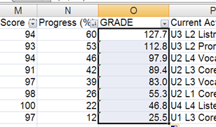
Final Grade
Notes:
At 60% Progress, the first Grade reflected here confirms that this first learner is well above the expected 47% Progress %.
By clicking and dragging the small black box her in the corner (CLICK 1), we will drag the formula down for every learner, where the value from the Progress column is divided by point 47, producing a final grade for every learner.

